Slide 1
LINUX AND SHELL SCRIPTING

Slide 2
Learning Outcomes
Obtain user and system information
Communicate with other users

Slide 3
Introduction
Some utilities that provide information about who is using the system, what those users are doing, and how the system is running.

Slide 4
Introduction
To find out who is using the local system, you can employ one of several utilities that vary in the details they provide and the options they support.

Slide 5
Obtaining User and System Information
who
finger
w

Slide 6
Obtaining User and System Information
The oldest utility, who, produces a list of users who are logged in on the local system, the device each person is using, and the time each person logged in.

Slide 7
Obtaining User and System Information
The w and finger utilities show more detail, such as each user’s full name and the command line each user is running.
You can use the finger utility to retrieve information about users on remote systems if the local system is attached to a network.

Slide 8
who: Lists Users on the System
The who utility displays a list of users who are logged in on the local system.

Slide 9
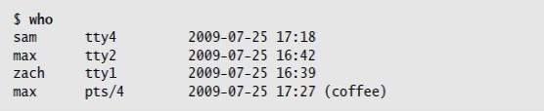
who: Lists Users on the System

Slide 10
who: Lists Users on the System
The information that who displays is useful when you want to communicate with a user on the local system.

Slide 11
who: Lists Users on the System
If you need to find out which terminal you are using or what time you logged in, you can use the command who am i:

Slide 12
who: Lists Users on the System

Slide 13
finger: Lists Users on the System
You can use finger to display a list of users who are logged in on the local system.
In addition to usernames, finger supplies each user’s full name along with information about which device the user’s terminal is connected to, how recently the user typed something on the keyboard, when the user logged in, and available contact information.
If the user has logged in over the network, the name of the remote system is shown as the user’s location.

Slide 14
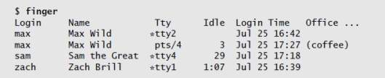
finger: Lists Users on the System

Slide 15
finger: Lists Users on the System
On systems where security is a concern, the system administrator may disable finger.

Slide 16
finger: Lists Users on the System
You can also use finger to learn more about an individual by specifying a username on the command line.

Slide 17
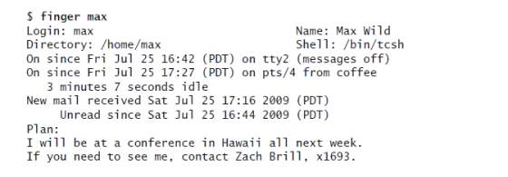
finger: Lists Users on the System

Slide 18
finger: Lists Users on the System
You can also use finger to display a user’s username.
The finger utility, which is not case sensitive, can search for information on Helen using her first or last name.

Slide 19
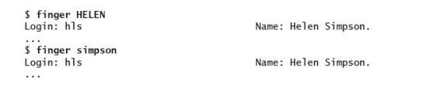
finger: Lists Users on the System

Slide 20
w: Lists Users on the System
The w utility displays a list of the users who are logged in on the local system.
The information that w displays is useful when you want to communicate with someone at your installation.

Slide 21
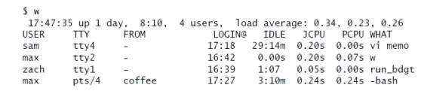
w: Lists Users on the System

Slide 22
w: Lists Users on the System
The first line the w utility displays includes the time of day, the period of time the computer has been running (in days, hours, and minutes), the number of users logged in, and the load average (how busy the system is).

Slide 23
Communicating with Other Users
These are used to exchange messages and files with other users either interactively or through email.

Slide 24
write: Sends a Message
Two-way communication.
The syntax of a write command line is
write username [terminal]

Slide 25
write: Sends a Message
The username is the username of the user you want to communicate with.
The terminal is an optional device name that is useful if the user is logged in more than once.
You can display the usernames and device names of all users who are logged in on the local system by using who, w, or finger.

Slide 26
write: Sends a Message
To establish two-way communication with another user, you and the other user must each execute write, specifying the other’s username as the username.
The write utility then copies text, line by line, from one keyboard/display to the other.

Slide 27
write: Sends a Message
Sometimes it helps to establish a convention, such as typing o (for “over”) when you are ready for the other person to type and typing oo (for “over and out”) when you are ready to end the conversation.

Slide 28
write: Sends a Message
When you want to stop communicating with the other user, press CONTROL-D at the beginning of a line.
Pressing CONTROL-D tells write to quit, displays EOF (end of file) on the other user’s terminal, and returns you to the shell. The other user must do the same.

Slide 29
write: Sends a Message
If the Message from banner appears on your screen and obscures something you are working on, press CONTROL- L or CONTROL- R to refresh the screen and remove the banner.
Then you can clean up, exit from your work, and respond to the person who is writing to you.
You have to remember who is writing to you, however, because the banner will no longer appear on the screen.

Slide 30
mesg: Denies or Accepts Messages
By default, messages to your screen are blocked.
Give the following mesg command to allow other users to send you messages: $ mesg y

Slide 31
mesg: Denies or Accepts Messages
If Max had not given this command before Zach tried to send him a message, Zach might have seen the following message: $ write max
write: max has messages disabled

Slide 32
mesg: Denies or Accepts Messages
You can block messages by entering mesg n.
Give the command mesg by itself to display is y (for “yes, messages are allowed”) or is n (for “no, messages are not allowed”).

Slide 33
mesg: Denies or Accepts Messages
If you have messages blocked and you write to another user, write displays the following message because, even if you are allowed to write to another user, the user will not be able to respond to you:
$ write max
write: write: you have write permission turned off.

Slide 34
Email
Email enables you to communicate with users on the local system and, if the installation is part of a network, with other users on the network.
If you are connected to the Internet, you can communicate electronically with users around the world.

Slide 35
Email
Email utilities differ from write in that email utilities can send a message when the recipient is not logged in. In this case the email is stored until the recipient reads it.
These utilities can also send the same message to more than one user at a time.

Slide 36
Email
Many email programs are available for Linux, including the original character-based mailx program, Mozilla/Thunderbird, pine, mail through emacs, KMail, and evolution.
Another popular graphical email program is sylpheed.

Slide 37
Email
Two programs are available that can make any email program easier to use and more secure.
The procmail program creates and maintains email servers and mailing lists; preprocesses email by sorting it into appropriate files and directories.
The GNU Privacy Guard encrypts and decrypts email and makes it almost impossible for an unauthorized person to read.

